Slide 1
Place Conflation Using Open-Source LLMs
Project C
Fall / November 2025
Presented by:
Jackie Fu
Company Name
Quarter Month
Year

Slide 2
Project Overview
Overture Maps receives millions of POI entries from different sources.
Many records refer to the same physical place, but with conflicting details (name/address/phone).
My Goal
Evaluate open-source LLMs to determine:
Which model provides the best accuracy + AUC + latency trade-off
Under realistic settings (fine-tuned vs zero-shot)
Models: Qwen2-7B FT, Qwen3-4B FT, Qwen3-4B Zero-Shot,
Qwen3-1.7B Zero-Shot

Slide 3
Project C — OKR Summary
KR1
KR2
KR3
Evaluate and compare multiple open-source Large Language Models (LLMs) for resolving duplicate place records using Overture’s 3K labeled dataset, identifying the most accurate and cost-efficient conflation approach.
Completed full preprocessing + cleaning of Overture 3K dataset
Created 70/10/20 stratified split
Built reproducible evaluation pipeline with:
  Accuracy, Precision, Recall, F1
  AUC-ROC, PR-AUC
  Latency per 1,000 predictions
Automated metric visualization (confusion matrix, ROC, PR curves)
Evaluated 4 model configurations:
Qwen2-7B-Instruct (FT) — completed
Qwen3-4B-Instruct (Zero-Shot) — completed
Qwen3-4B-Instruct (FT) — completed
Qwen3-1.7B Zero-Shot — completed
Additional goals:
≥1,000 predictions evaluated/model
Optimized QLoRA hyperparameters
Best Performance targets (met or exceeded):
  F1 ≥ 0.80
  AUC ≥ 0.85
  Latency < 3s/query
Built summary tables comparing:
  Accuracy/Precision/Recall/F1
  AUC-ROC, PR-AUC
  Latency per 1,000 samples
Produced ROC/PR curves for all models
Conducted error analysis on ≥10 representative pairs

Slide 4
Approach & Methodology
Dataset Pipeline
Modeling Approach
Trade-offs
Clean raw Overture parquet → CSV
Extract:
  name, category, address, website, phone
Convert to SFT JSONL (train/val/test)
Apply A/B reversible augmentation
QLoRA fine-tuning for 7B and 4B models
Unified evaluation script:
  Hard labels
  Token-level YES/NO probability for AUC
  ROC/PR curves
  Latency profiling
7B: Higher accuracy, slower latency
4B: Slightly lower accuracy, faster inference (better cost/performance)

Slide 5
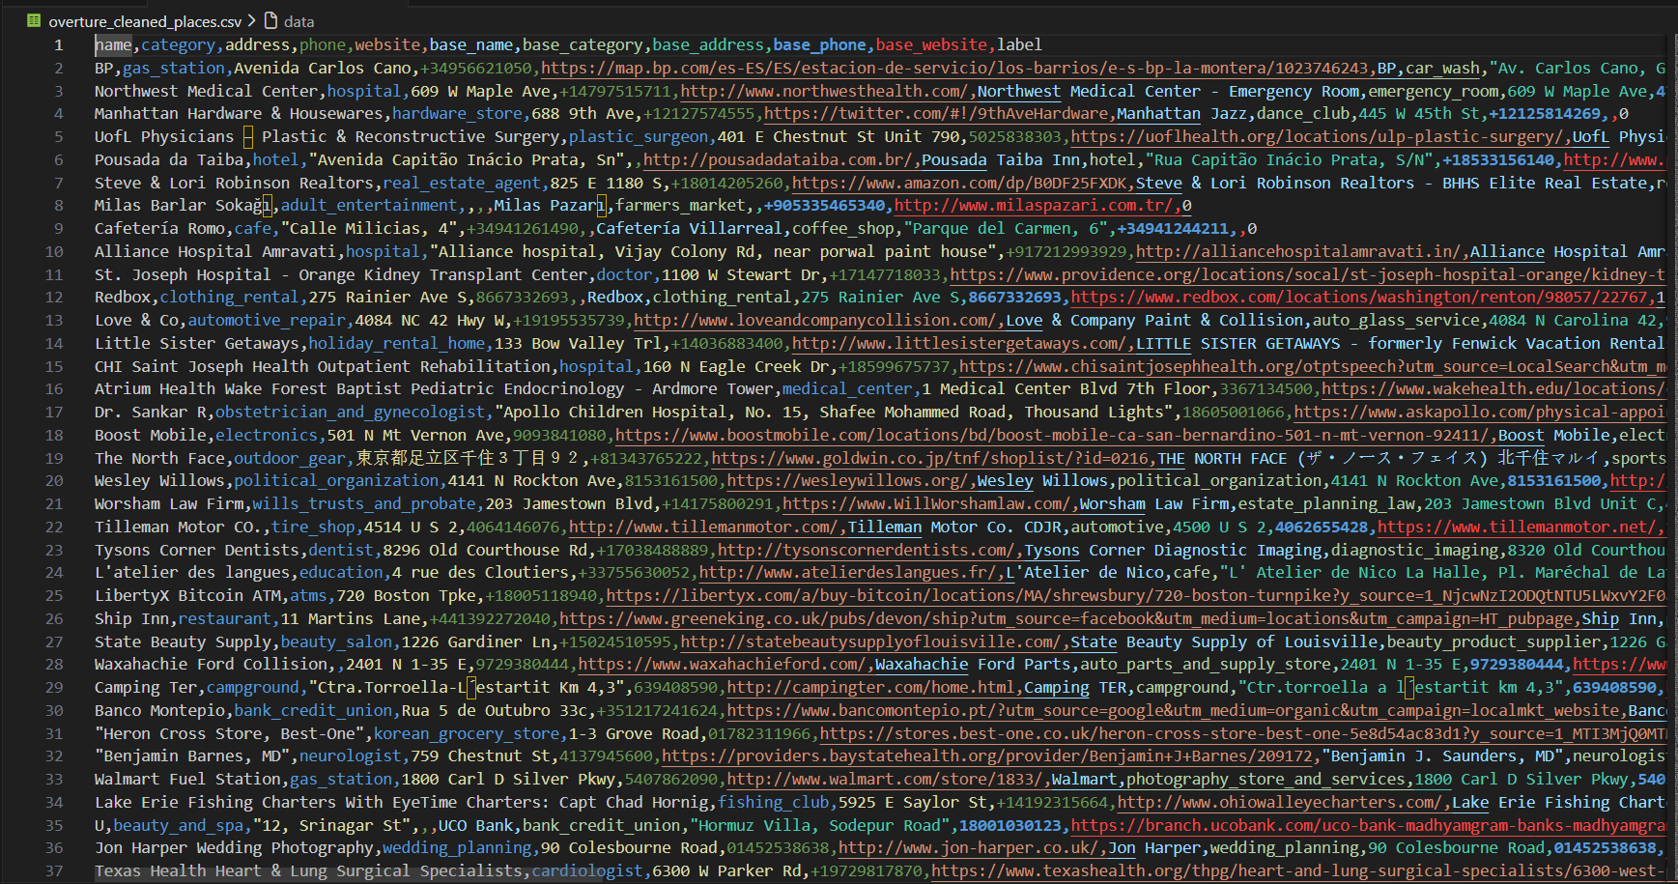
Demo - My Step 1-data clean and convert
First, I clean the dataset; remove unnecessary columns with a lot of empty strings from the source dataset, and create the csv file for the rest data set that remain.

Slide 6
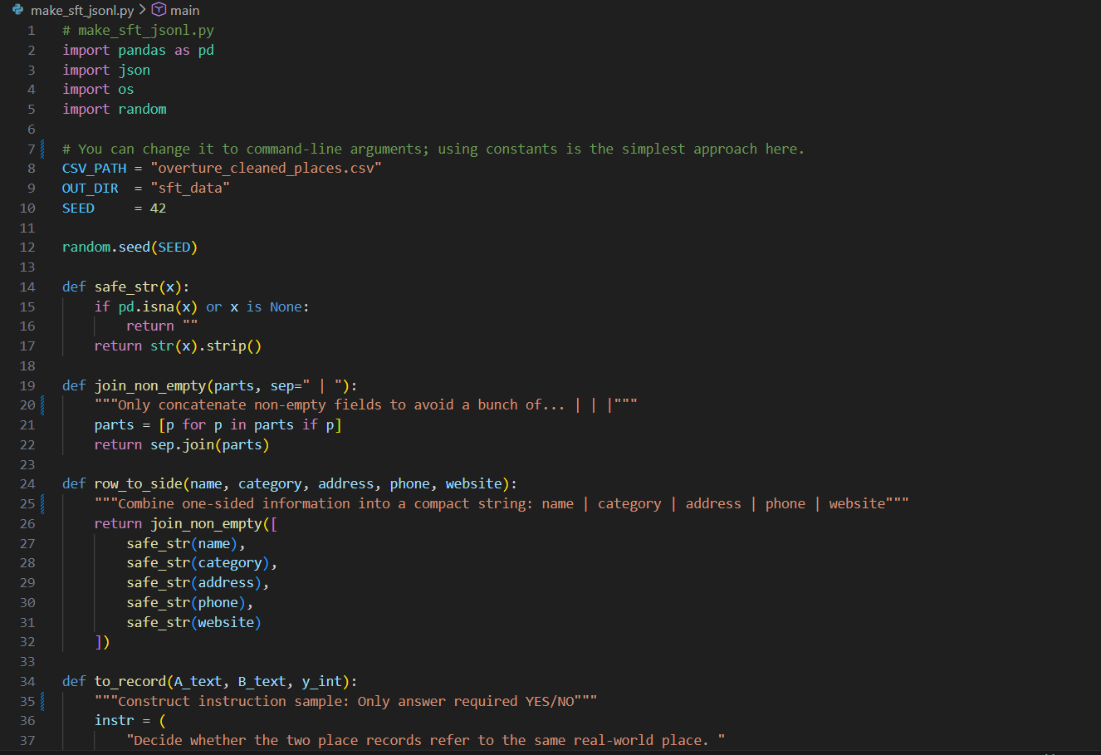
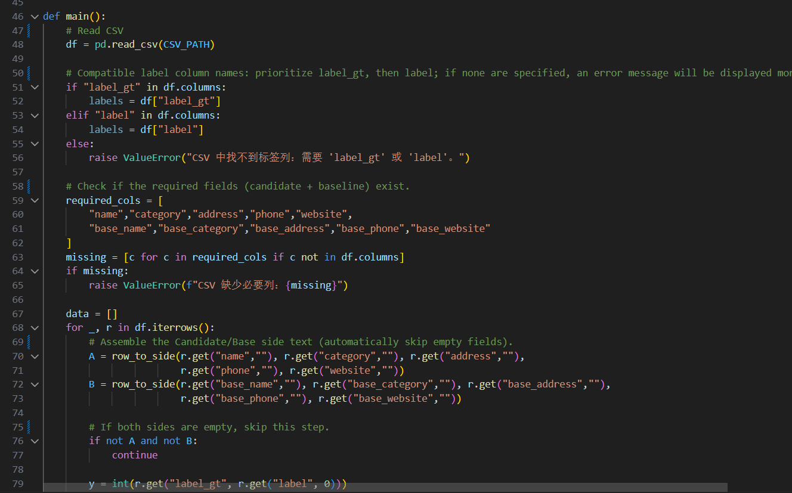
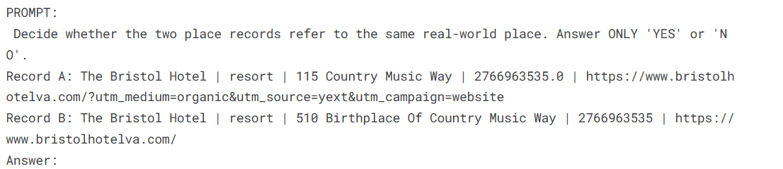
Demo - My Step 2-data split and prompt
Then I wrote a Python file called `make_sft_jsonl.py` to split the dataset for test, training, and evaluating. I also packaged the data into a suitable JSON format with prompt words.

Slide 7
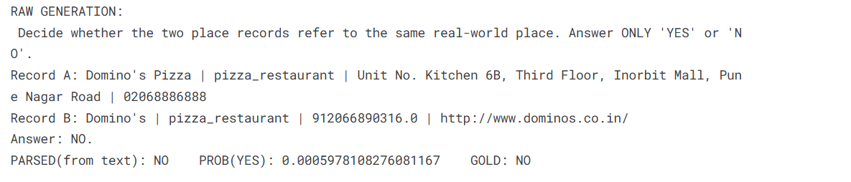
Demo - My Step 3 - zero shot model-Qwen3 4b
“This example shows how the zero-shot Qwen3-4B model performs on a real place-pair.
Given two Domino’s records, the model predicts NO, correctly identifying that they refer to different locations.
In this case, the model’s reasoning is correct — the addresses and phone numbers differ significantly, and the gold label is also NO.
It also assigns a very low YES probability (0.00059), showing high confidence.
This serves as a baseline before fine-tuning, helping us compare how model performance improves after training.”

Slide 8
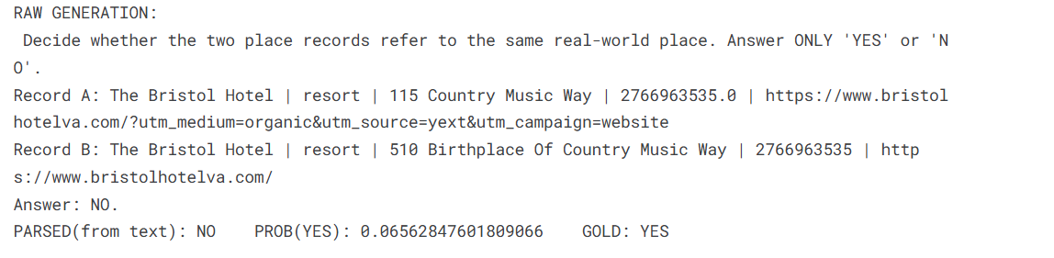
Demo - My Step 3 - Qwen3 4b Error Example
“This example shows a case where the zero-shot Qwen3-4B model predicts incorrectly.
Although both records clearly refer to The Bristol Hotel at slightly different address formats, the model outputs NO, while the gold label is YES.
The model assigns only 0.066 probability to ‘YES’, meaning it fails to recognize these as the same place.
This highlights the limitations of zero-shot and demonstrates why fine-tuning is necessary for higher accuracy.”

Slide 9
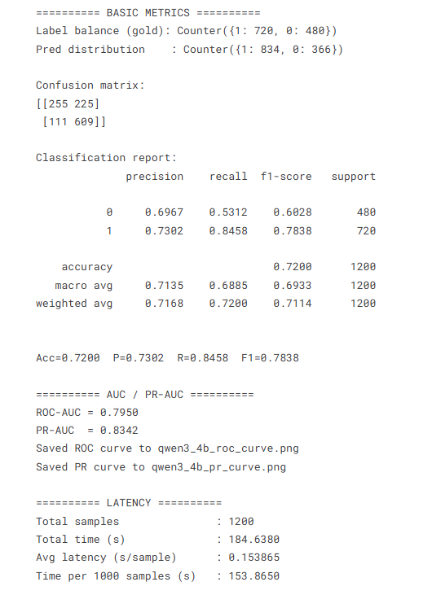
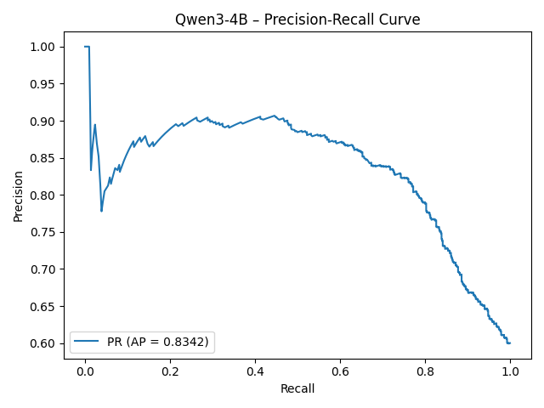
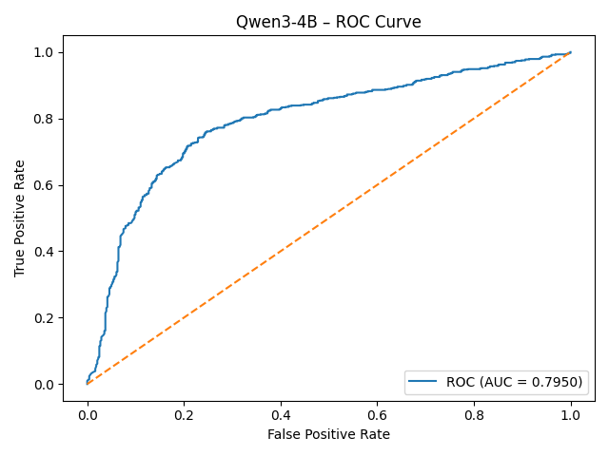
Demo - My Step 3 - Qwen 3 4b Result Overview
“This is shows the performance of the zero-shot Qwen3-4B model on the test set.
Without any fine-tuning, the model reaches around 72% accuracy and an F1-score of 0.78.
Its ranking metrics, including ROC-AUC of 0.79 and PR-AUC of 0.83, show moderate discriminative ability.
These results establish a meaningful baseline, but also highlight the limitations of zero-shot performance on place conflation—especially compared to the much stronger fine-tuned models shown later.”

Slide 10
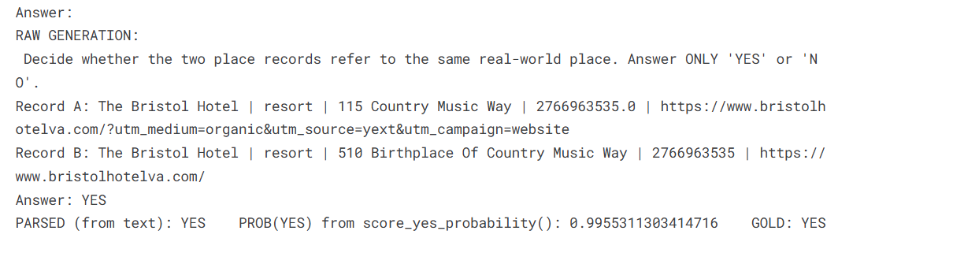
Demo - My Step 4 - FT model-Qwen3 4b
“This example shows how the fine-tuned Qwen3-4B model performs on the same pair where the zero-shot model failed.
After training, the model correctly predicts YES, matching the gold label, and assigns a very high confidence of 0.9955.
This demonstrates how fine-tuning dramatically improves the model’s ability to recognize real-world place equivalence.”

Slide 11
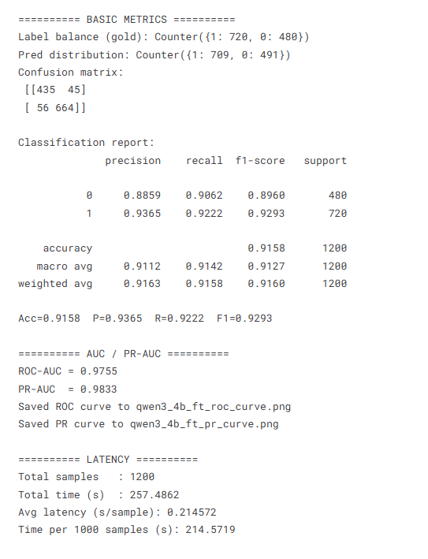
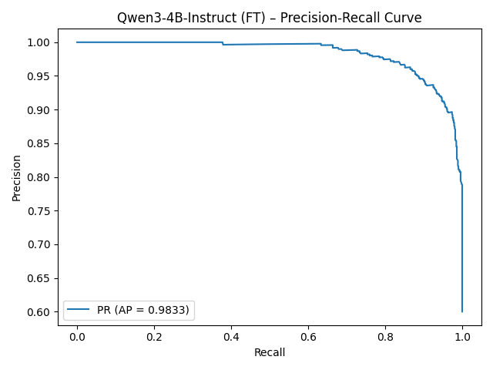
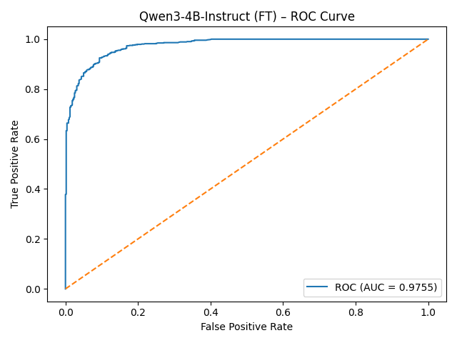
Demo-My Step 4-Qwen 3 4b FT Result Overview
“This is shows the performance of the fine-tuned Qwen3-4B model.
After training on the Overture dataset, the model achieves 91.6% accuracy and an F1-score of 0.93, which is a significant improvement over the zero-shot baseline.
Its ranking metrics are also extremely strong, with ROC-AUC of 0.9755 and PR-AUC of 0.9833, indicating excellent ability to distinguish matching versus non-matching place pairs.
The model is also efficient, with an average latency of just 0.21 seconds per sample, making it a practical option for scalable conflation.”

Slide 12
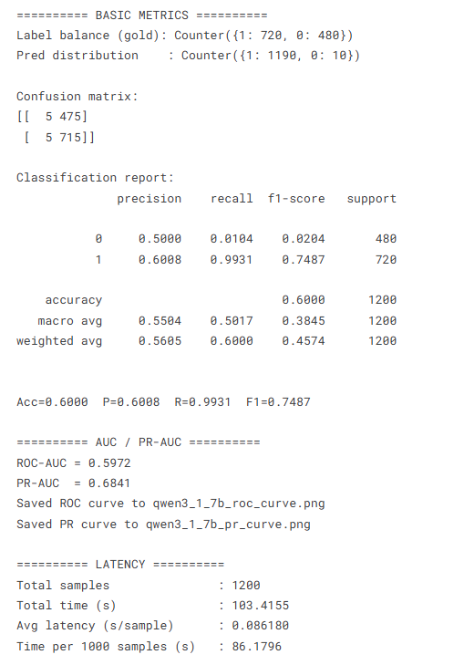
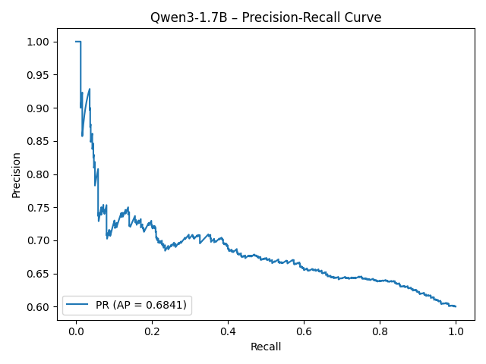
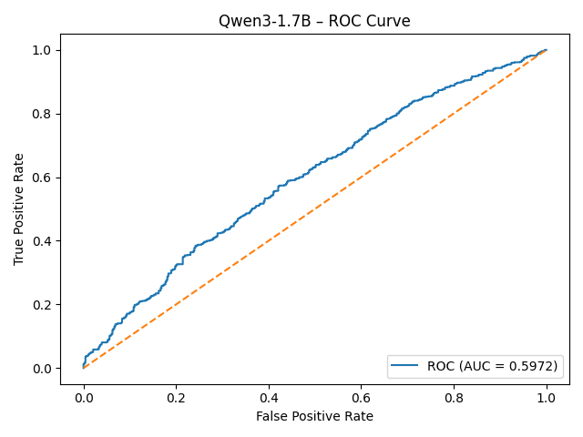
Other Demo-Qwen3 1.7b Zero Shot Result Overview
“This is shows performance of the zero-shot smaller Qwen3-1.7B model.
Since it wasn’t fine-tuned on the Overture dataset, its accuracy is only 60%, Precision is 60% and Recall is 99.3% with an F1 around 0.75.
Which the result shows that the Qwen3-1.7B model tends to say ‘YES’ almost all the time, regardless of the actual ground truth.
Because the model was too small and not fine-tuned at all, it doesn’t understand the structure of Overture place records, so it over-predicts matches and performs poorly on both ROC and PR curves."

Slide 13
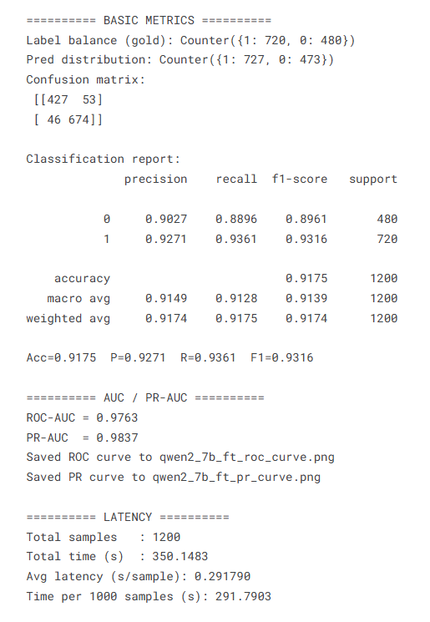
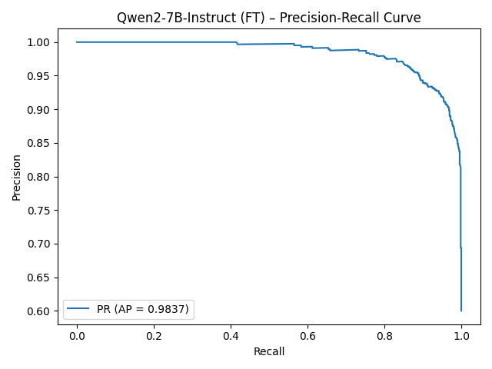
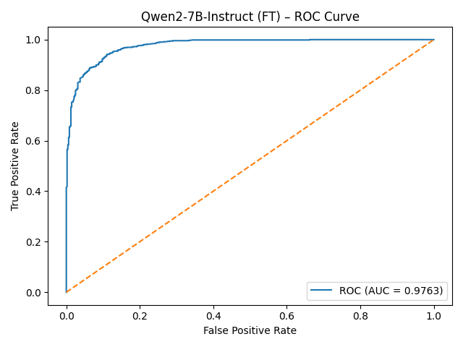
Other Demo-Qwen2 7b FT Result Overview
“These results show that the fine-tuned Qwen2-7B model performs extremely well on this task.
It achieves high accuracy (91.75%), and high F1(93.16%) with ROC-AUC 0.9763 and PR-AUC 0.9837, meaning the model can reliably distinguish matching vs. non-matching place records.
This confirms that fine-tuning significantly boosts model understanding, producing stable and highly accurate predictions.”

Slide 14
Outcome Quick Snapshot Sheet
Model | Setting | Accuracy | Recall | F1-score | AUC-ROC | PR-AUC | Latency (s/sample) | Notes
Qwen-2 7B | Fine-tuned | 0.9175 | 0.9361 | 0.9316 | 0.9763 | 0.9837 | 0.2918 | Highest accuracy; very strong baseline
Qwen-3 4B | Fine-tuned | 0.9158 | 0.9222 | 0.9293 | 0.9755 | 0.9833 | 0.2146 | Best speed/performance trade-off
Qwen-3 4B | Zero-shot | 0.7288 | 0.8458 | 0.7838 | 0.7892 | 0.8286 | 0.1539 | Strongest zero-shot baseline
Qwen-3 1.7B | Zero-shot | 0.6008 | 0.9917 | 0.7488 | 0.5820 | 0.6528 | 0.0862 | Poor performance → not used for FT

Slide 15
Reflection
This project helped me understand how different model sizes and training strategies affect place-matching performance. Fine-tuned models gave strong, reliable results, while small zero-shot models showed bias and inconsistency.
If I could improve anything, I would refine the dataset and explore better-balanced samples. Stakeholder feedback also reminded me to focus on clarity, reliability, and real-world usability.
For future work, I hope to test larger distilled models, try embedding-based methods, and explore deployment options for real-time workflows.

Slide 16
Thank You

